Slide 1
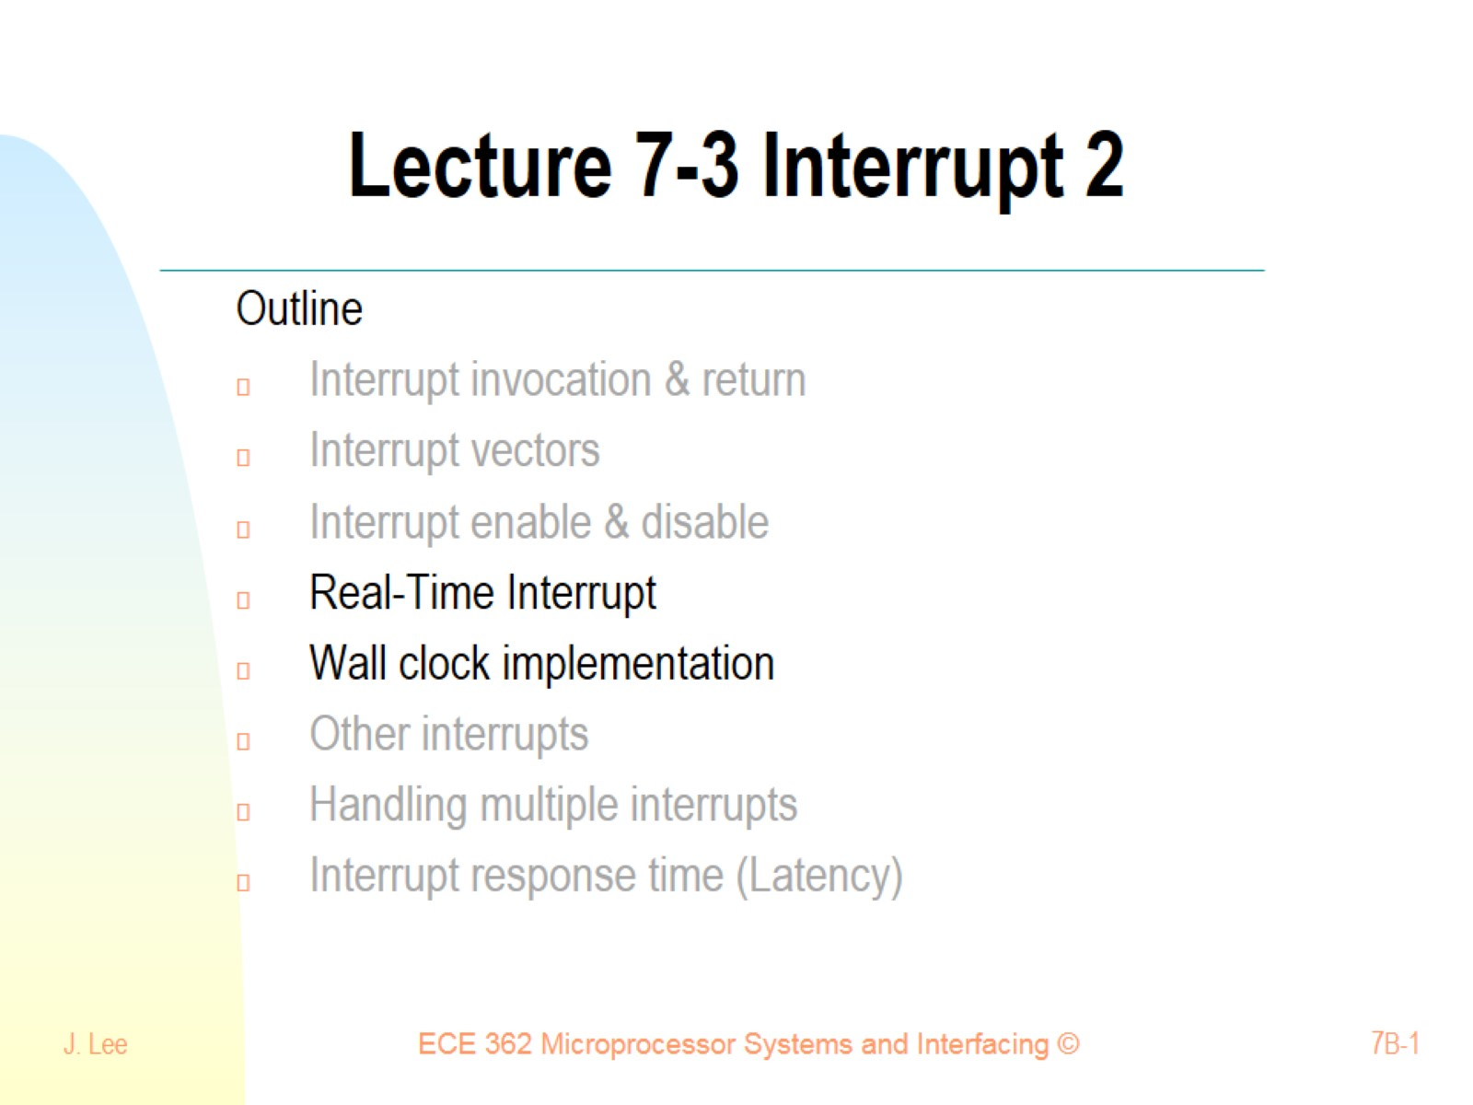
Lecture 7-3 Interrupt 2

Slide 2
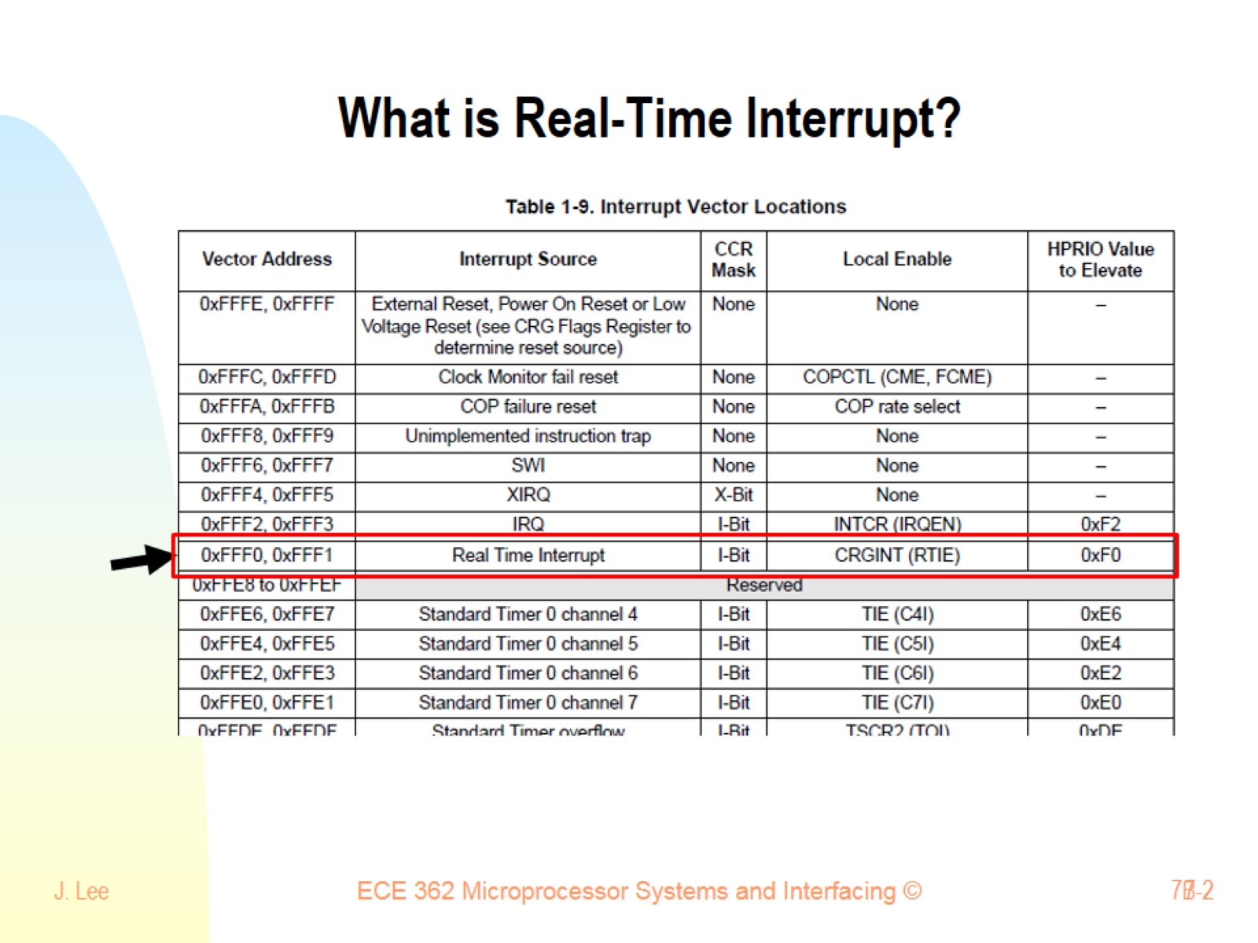
What is Real-Time Interrupt?

Slide 3
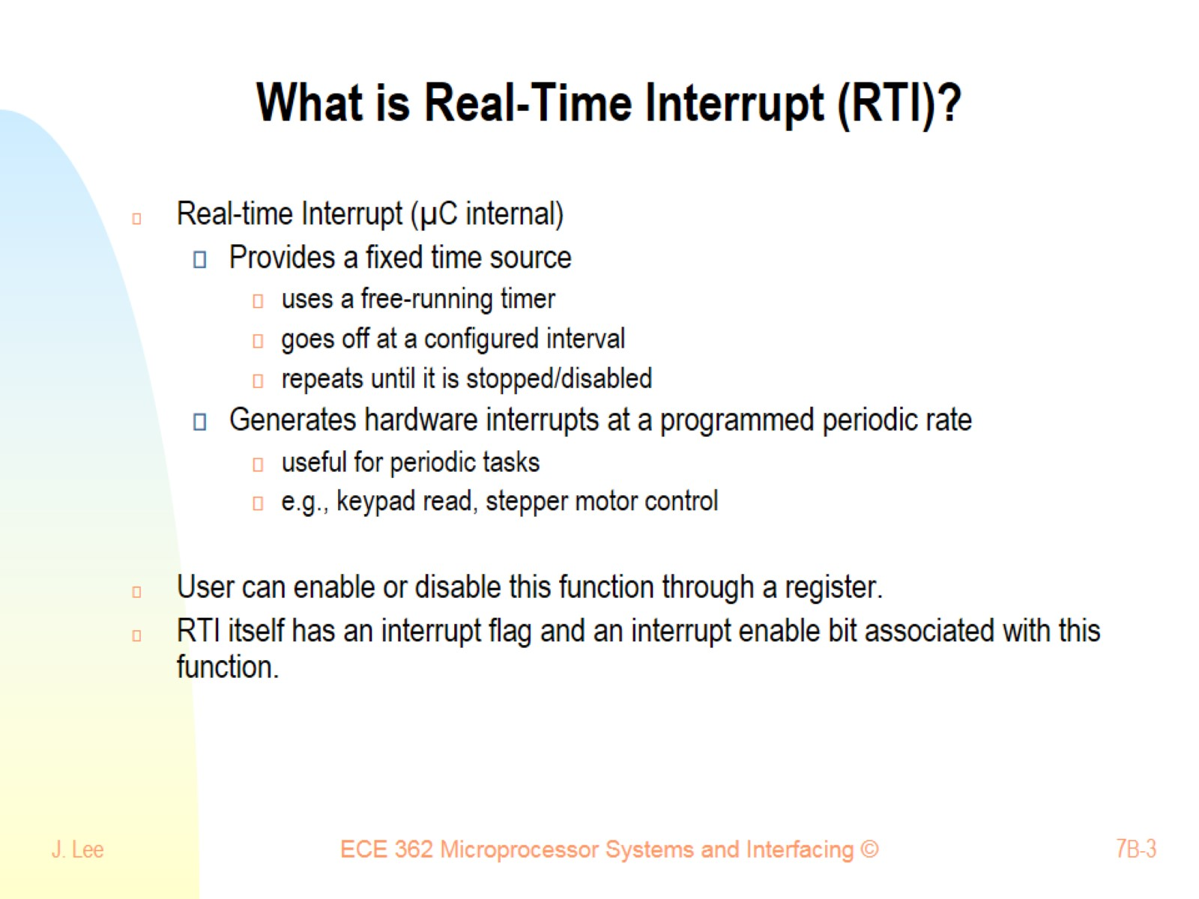
What is Real-Time Interrupt (RTI)?

Slide 4
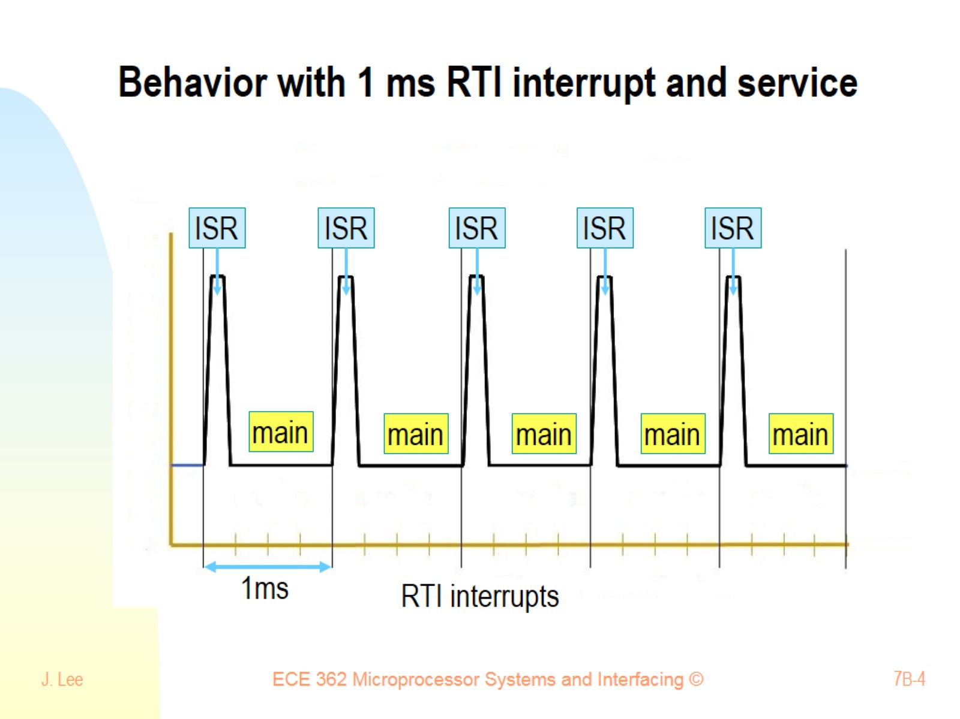
Behavior with 1 ms RTI interrupt and service

Slide 5
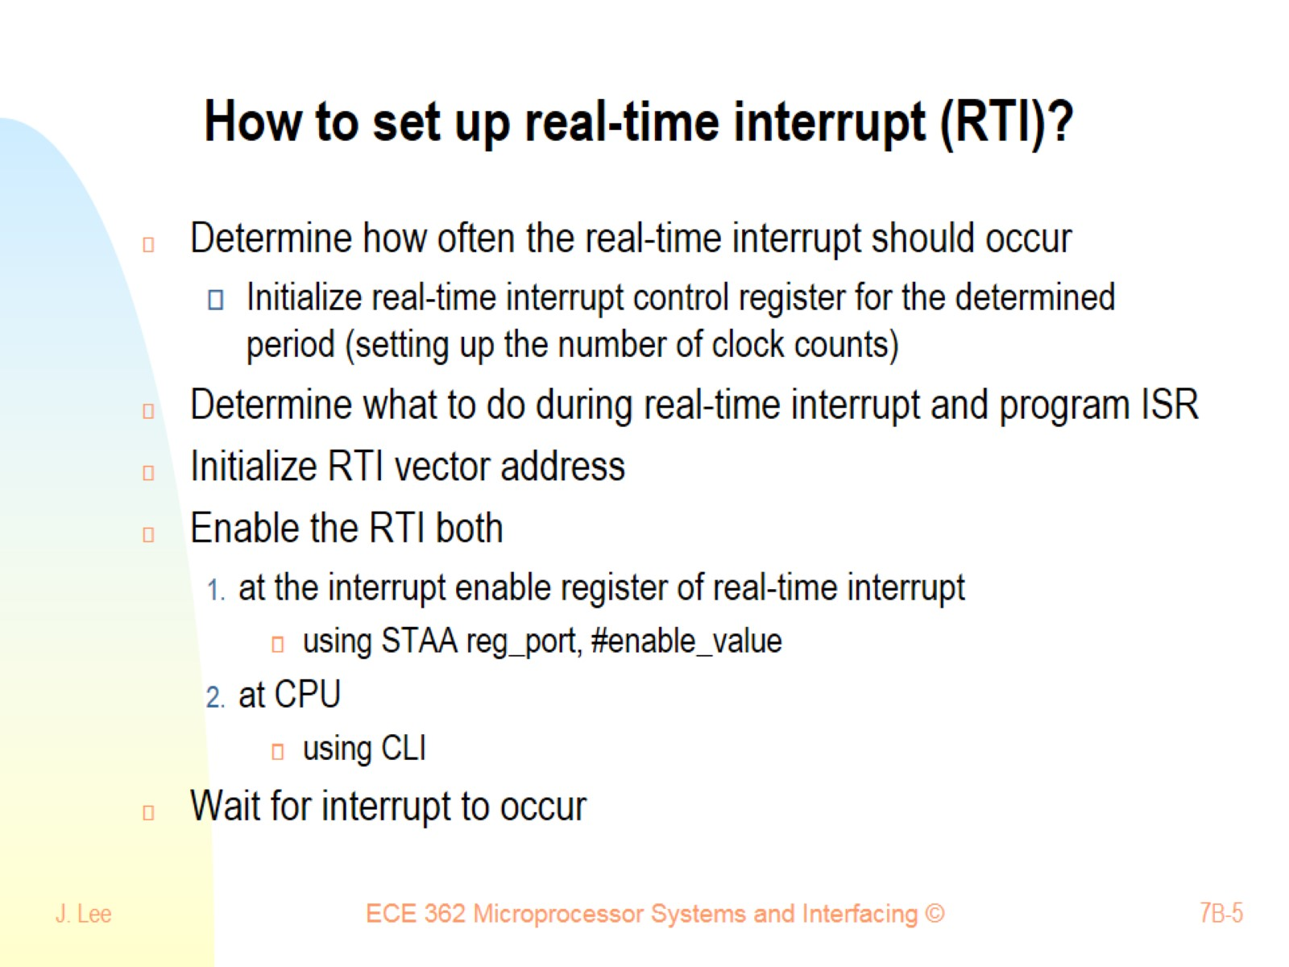
How to set up real-time interrupt (RTI)?

Slide 6
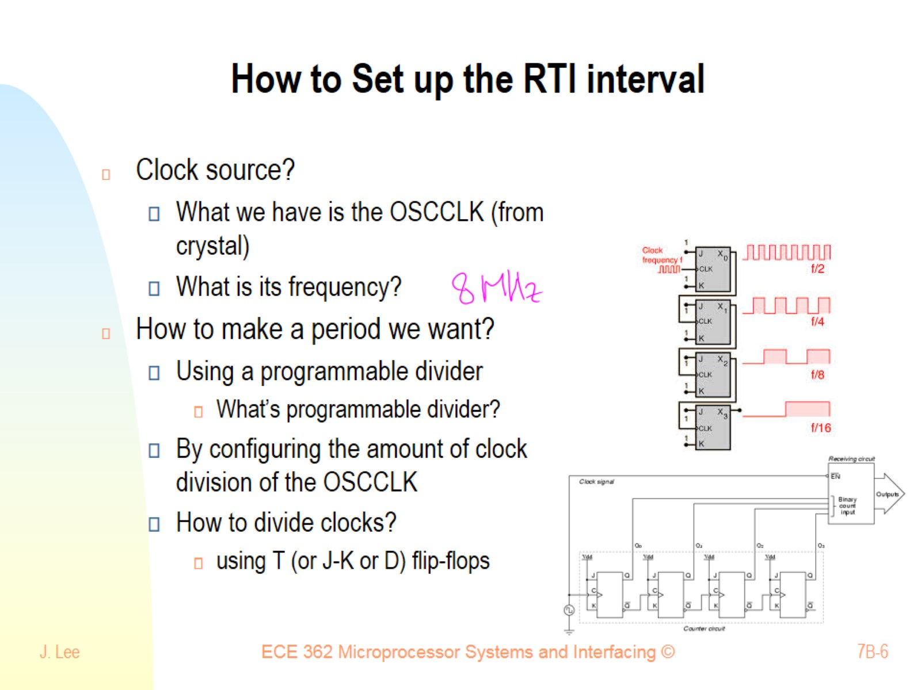
How to Set up the RTI interval

Slide 7
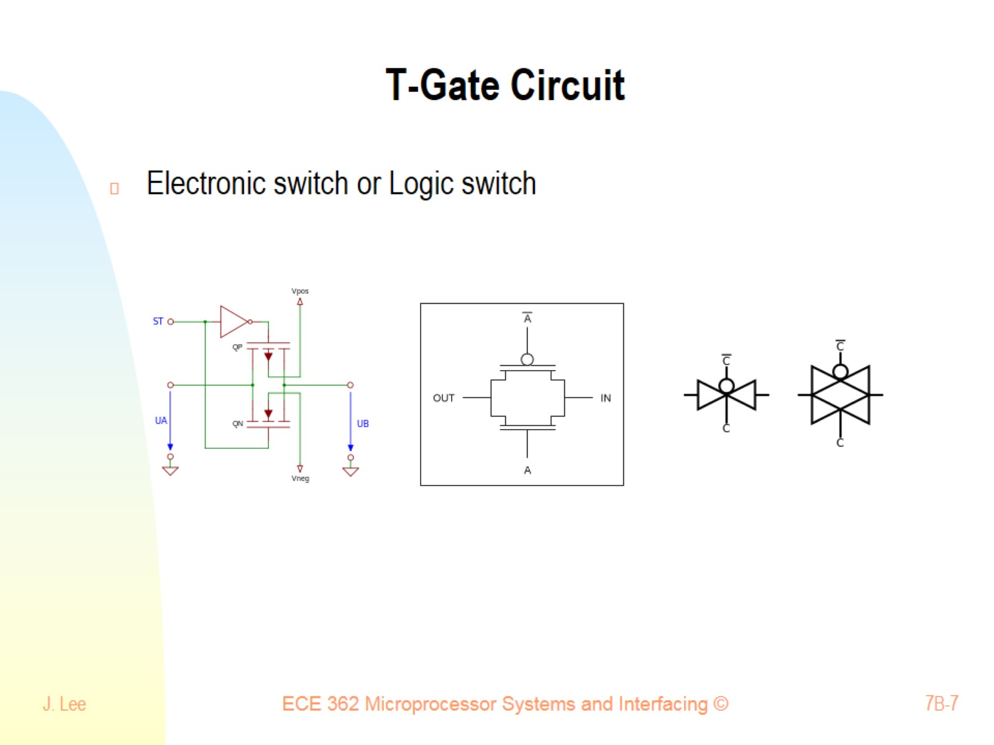
T-Gate Circuit

Slide 8
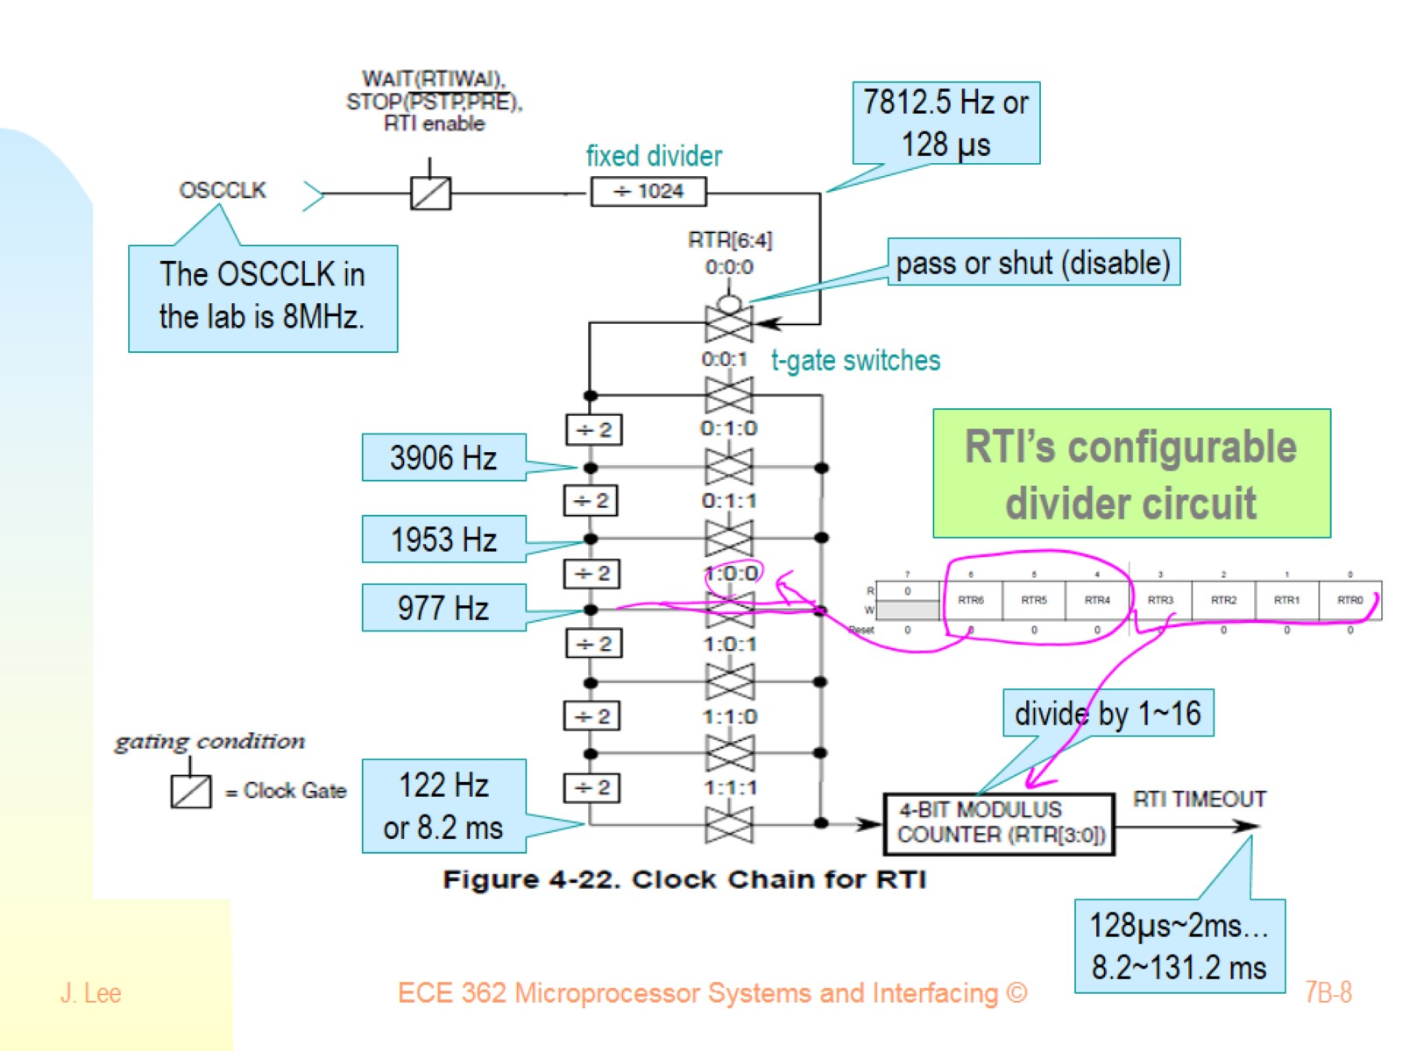

Slide 9
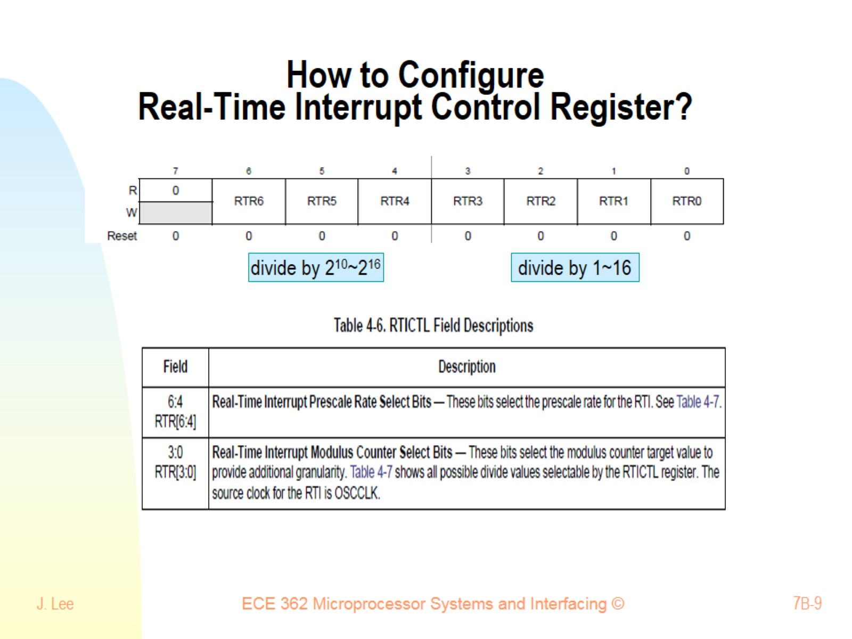
How to Configure Real-Time Interrupt Control Register?

Slide 10
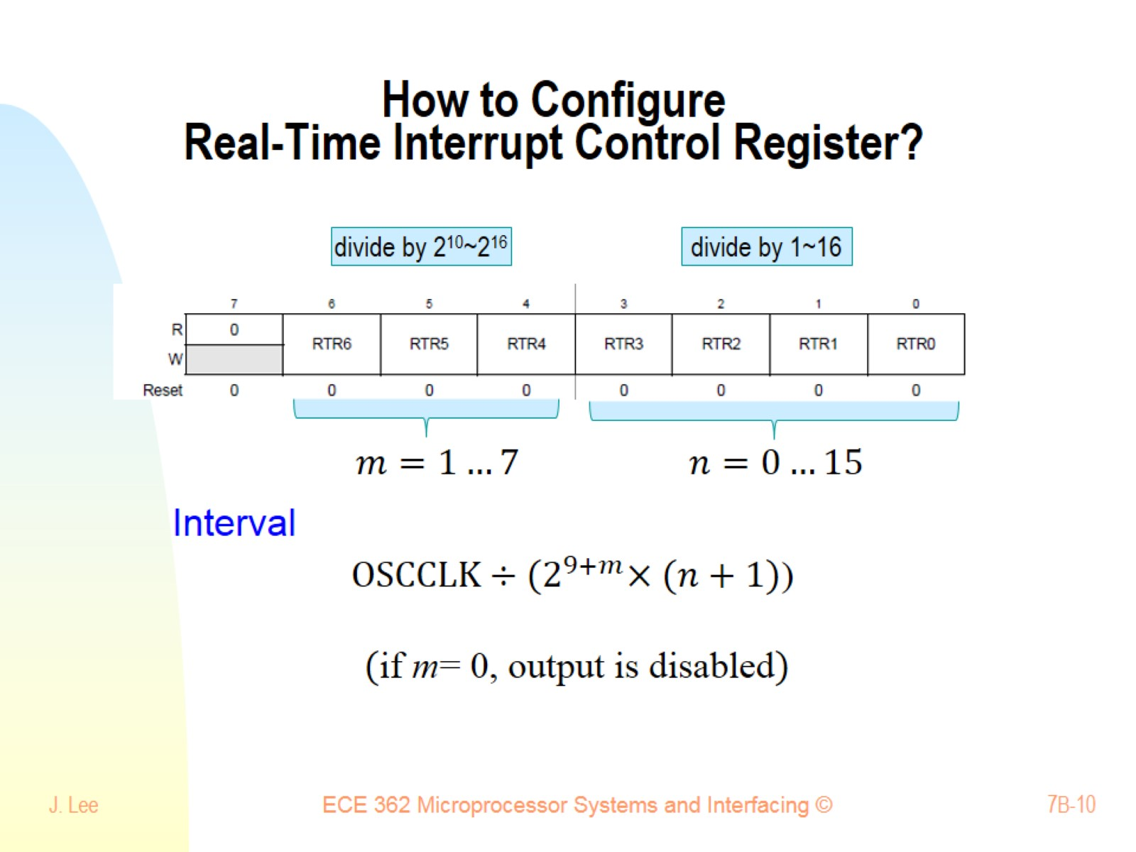
How to Configure Real-Time Interrupt Control Register?

Slide 11
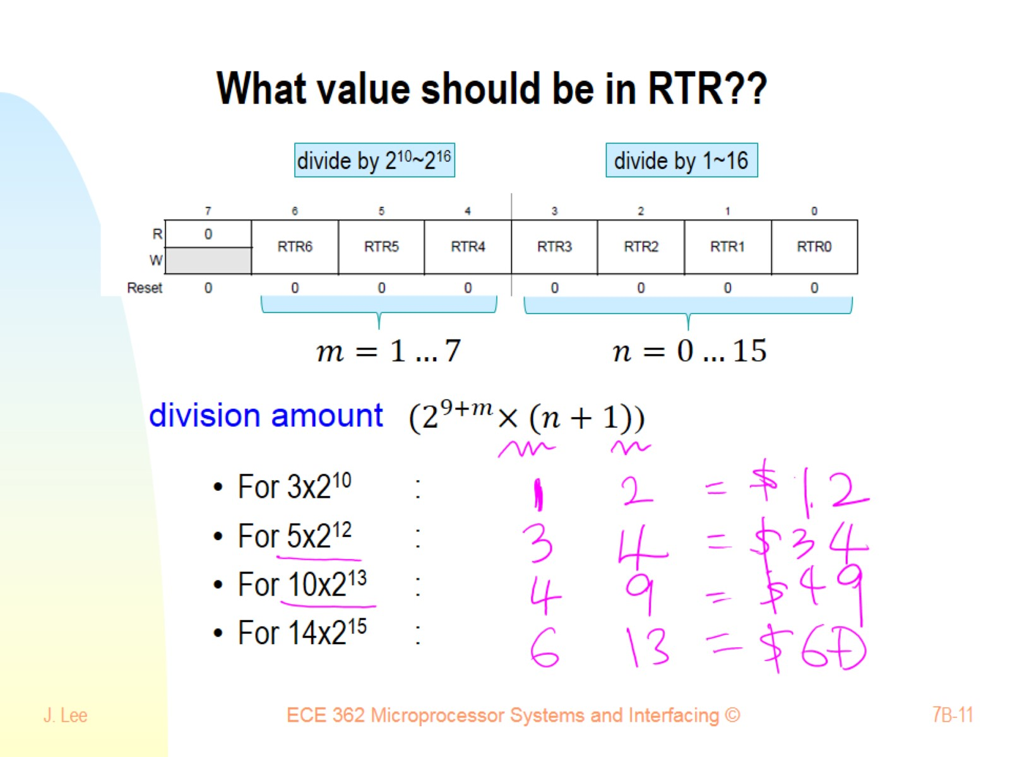
What value should be in RTR??

Slide 12
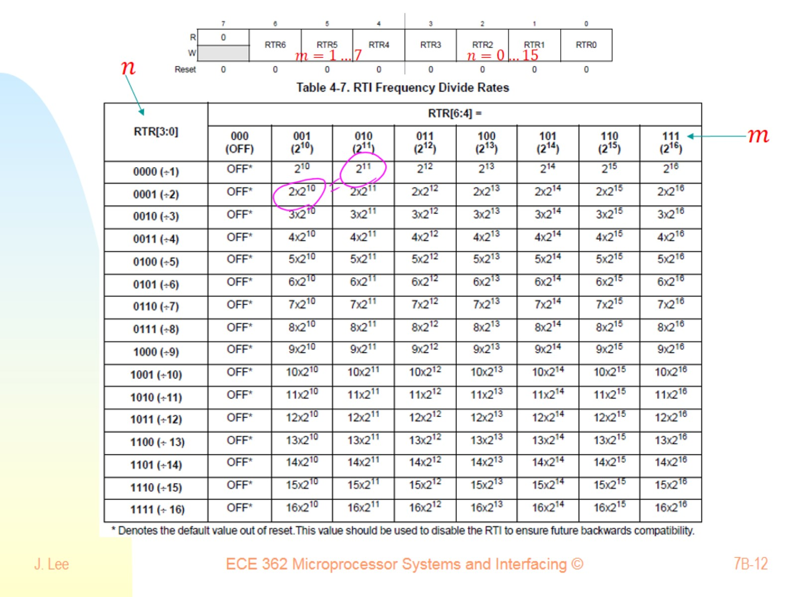

Slide 13
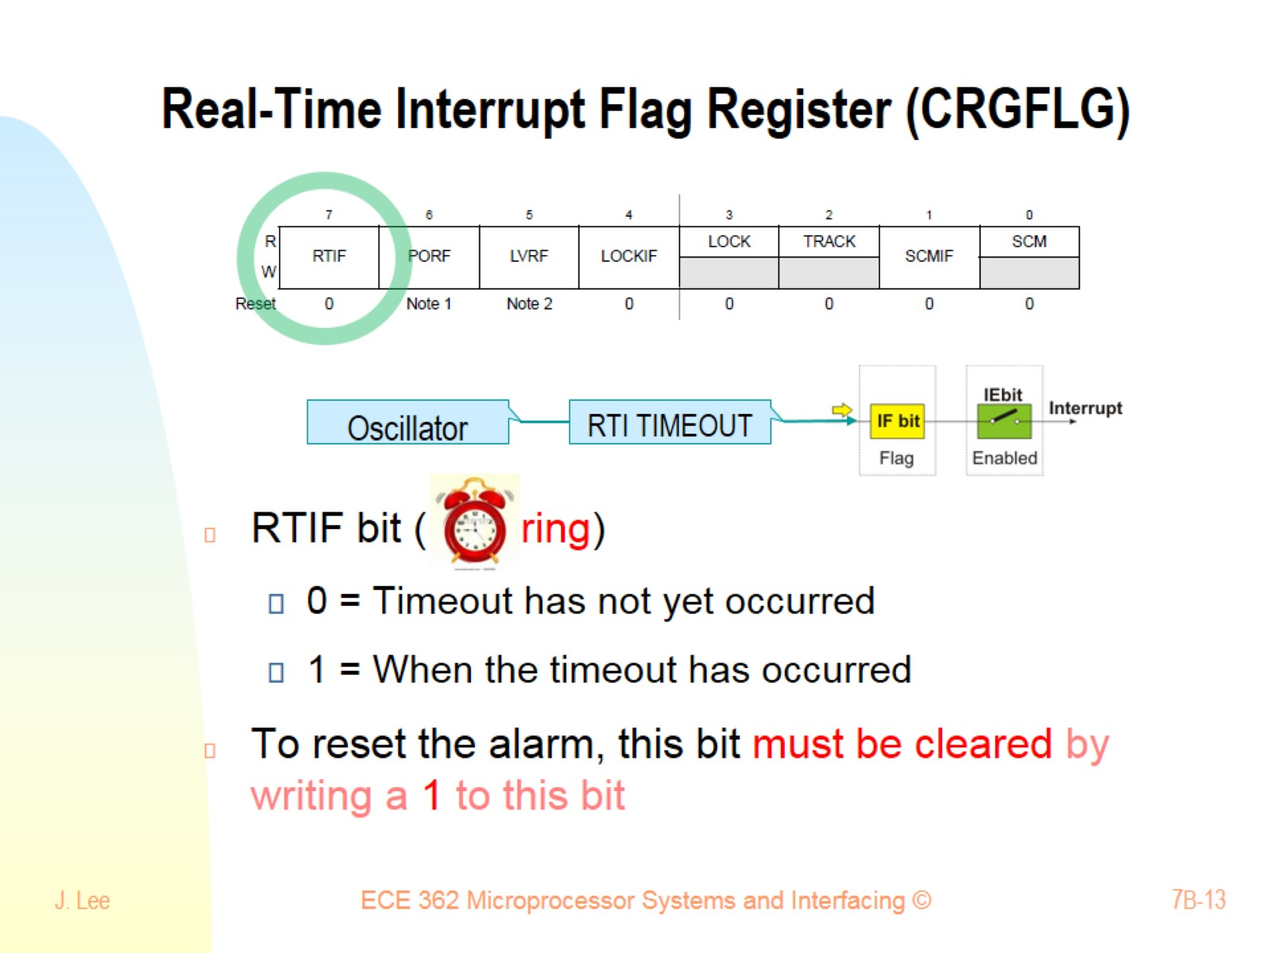
Real-Time Interrupt Flag Register (CRGFLG)

Slide 14
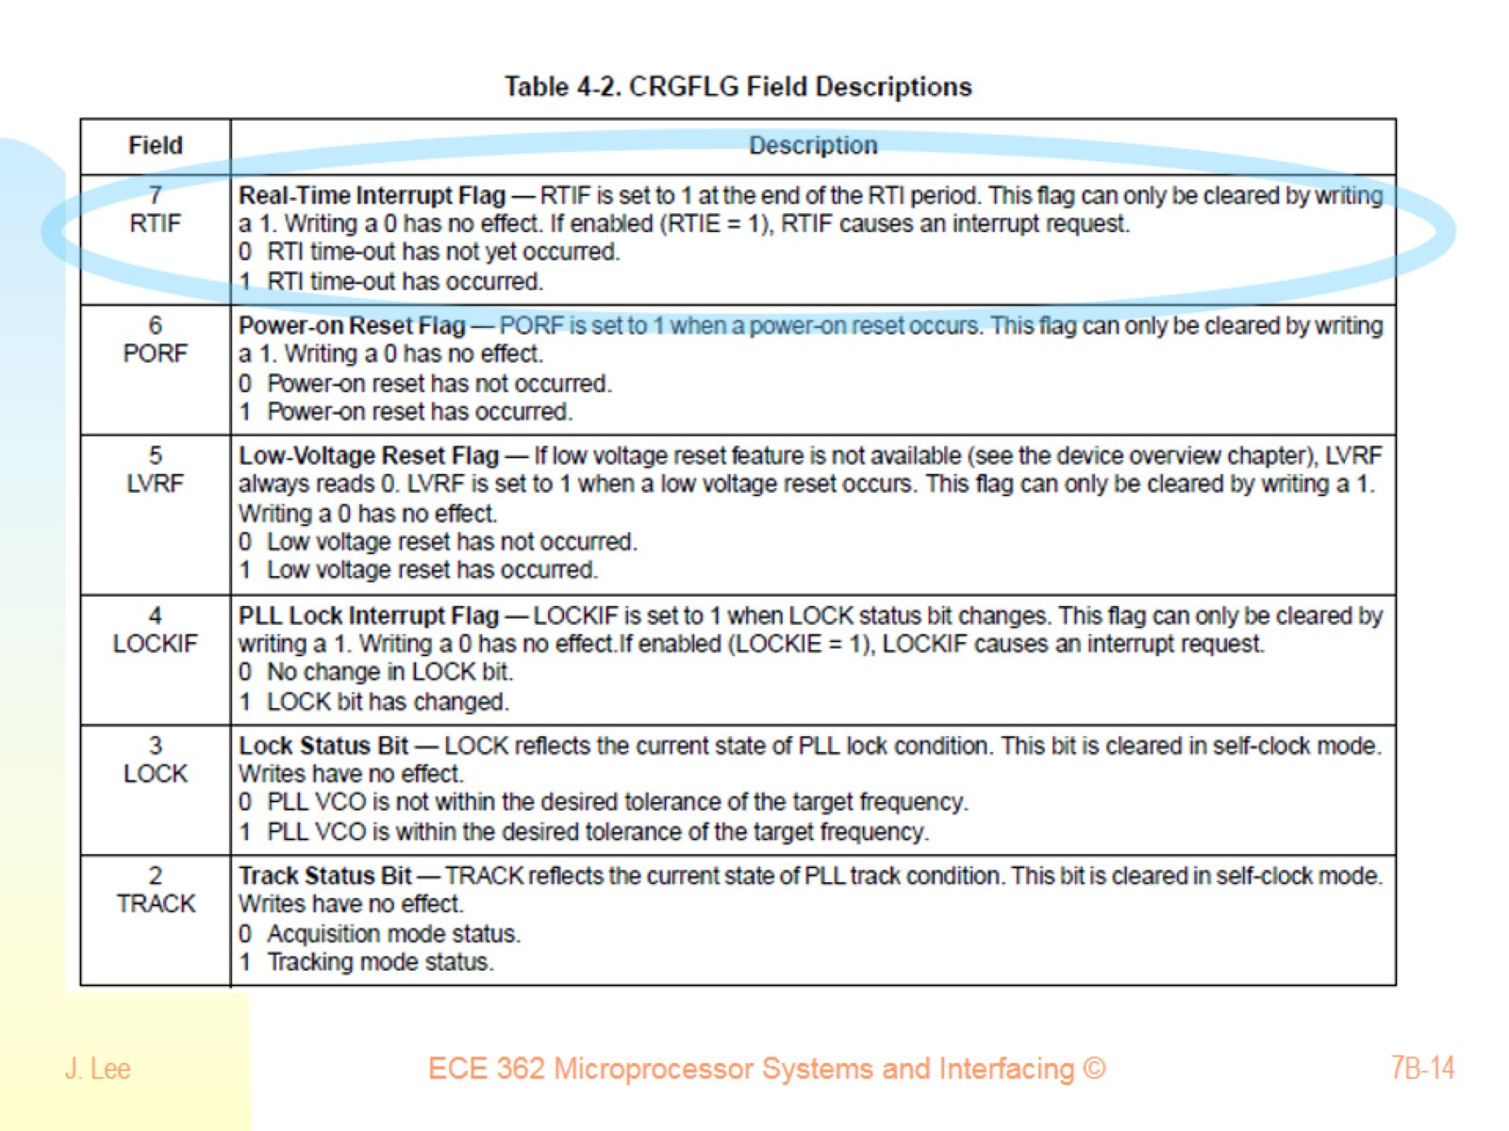

Slide 15
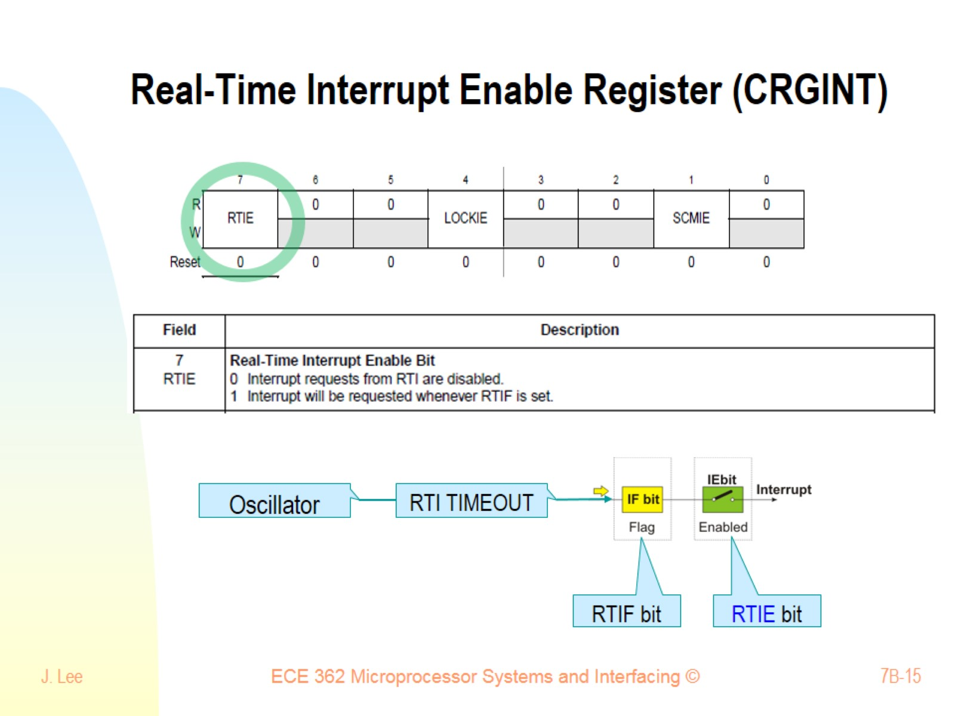
Real-Time Interrupt Enable Register (CRGINT)

Slide 16
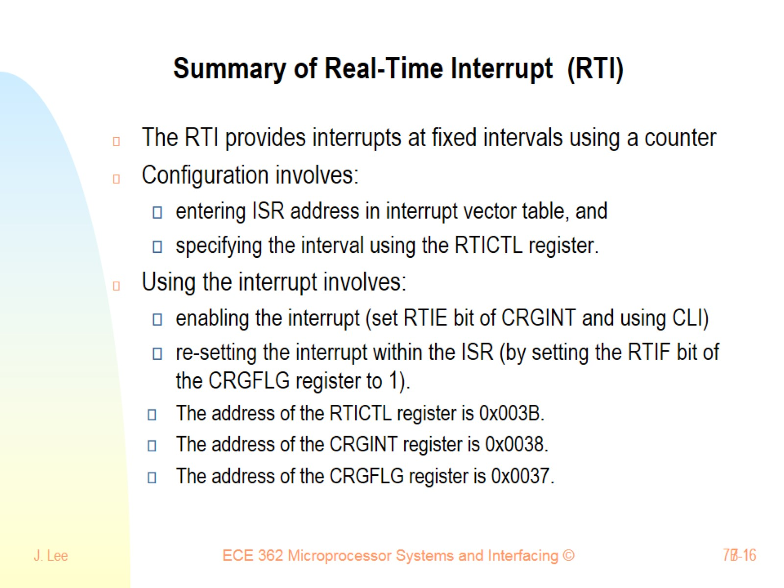
Summary of Real-Time Interrupt (RTI)

Slide 17
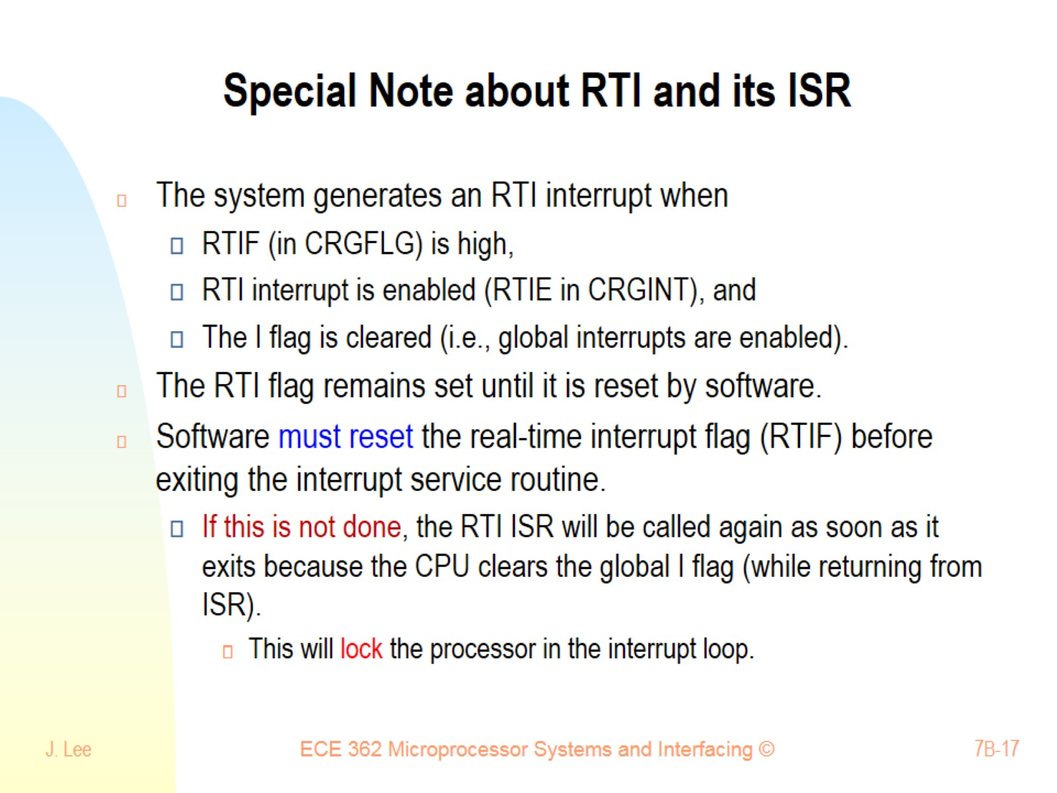
Special Note about RTI and its ISR

Slide 18
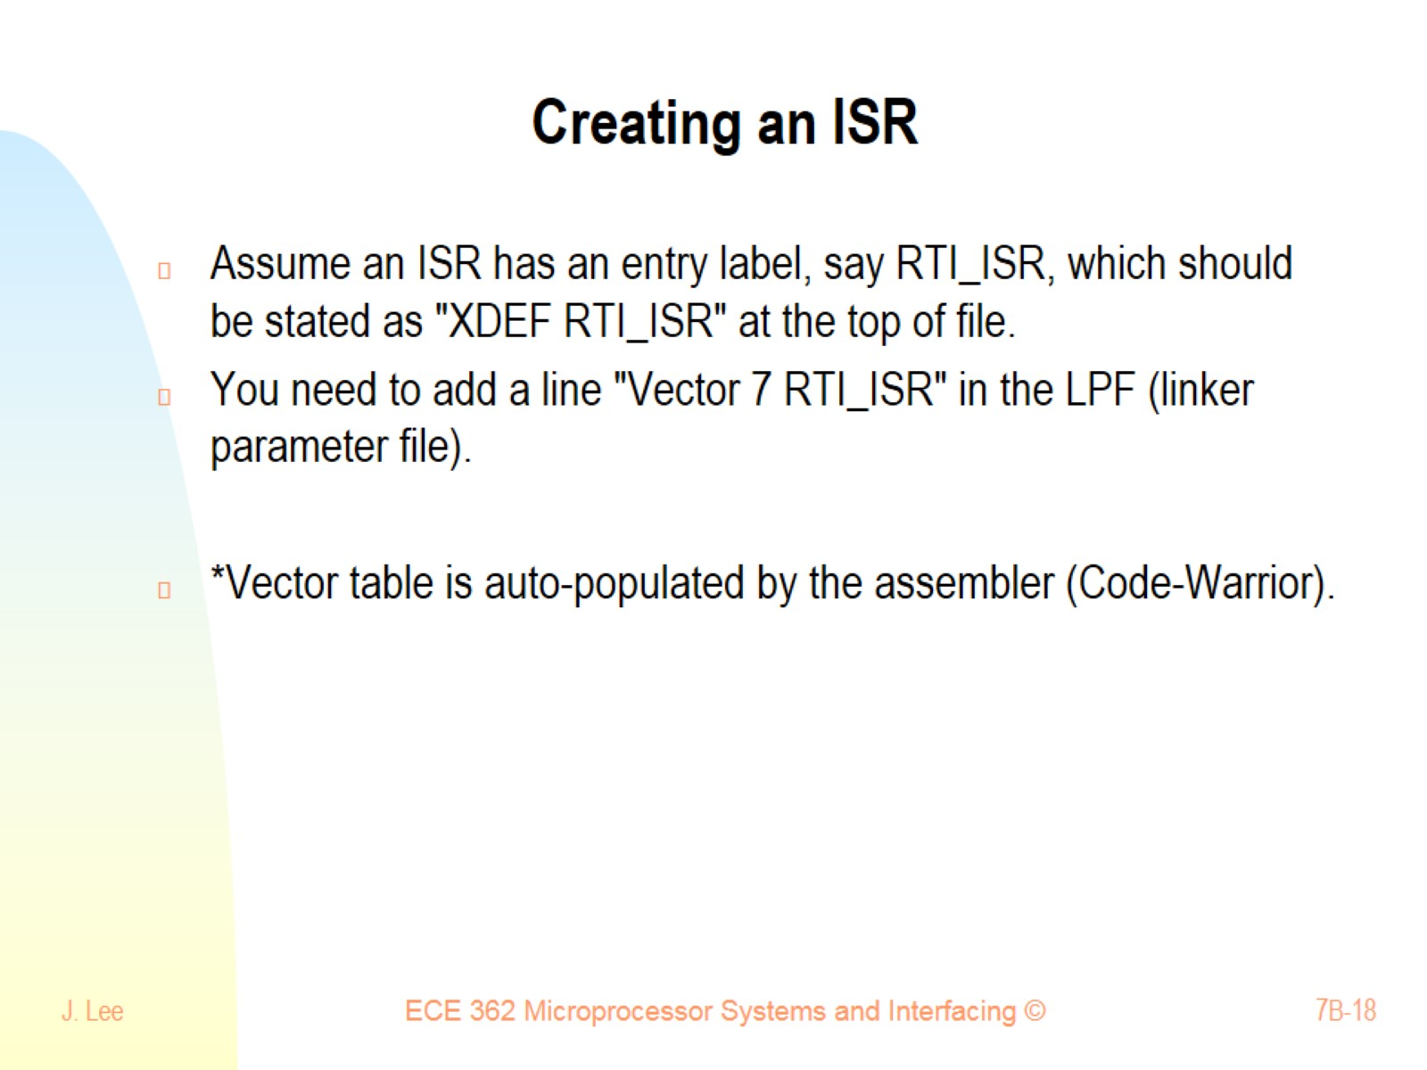
Creating an ISR

Slide 19
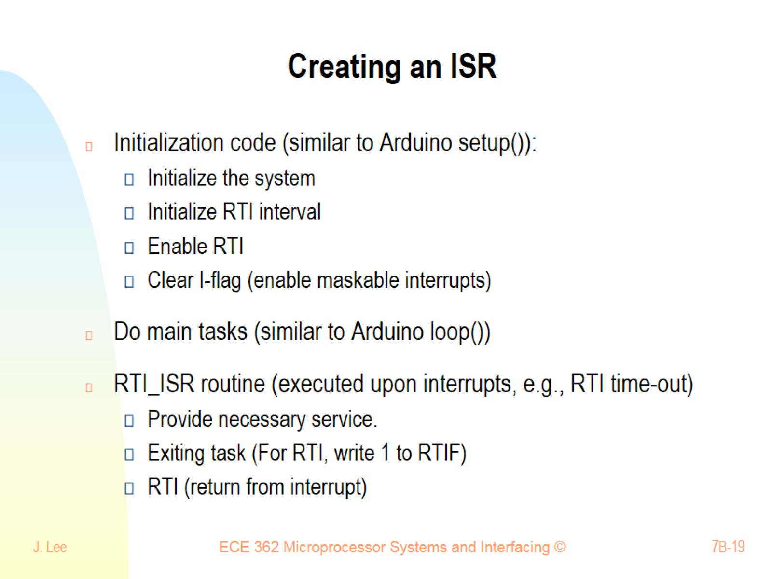
Creating an ISR

Slide 20
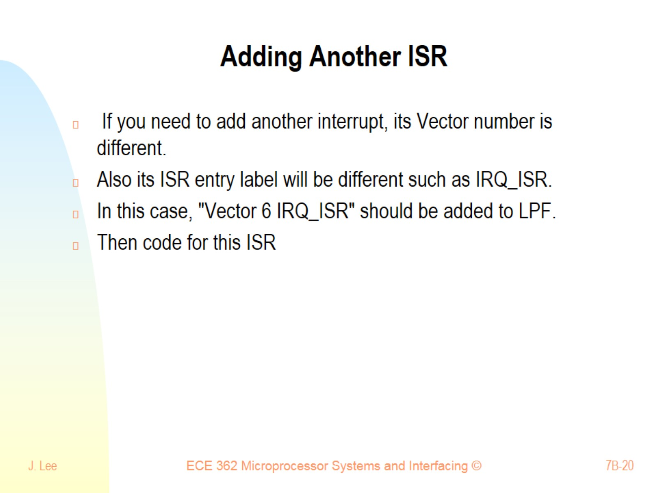
Adding Another ISR

Slide 21
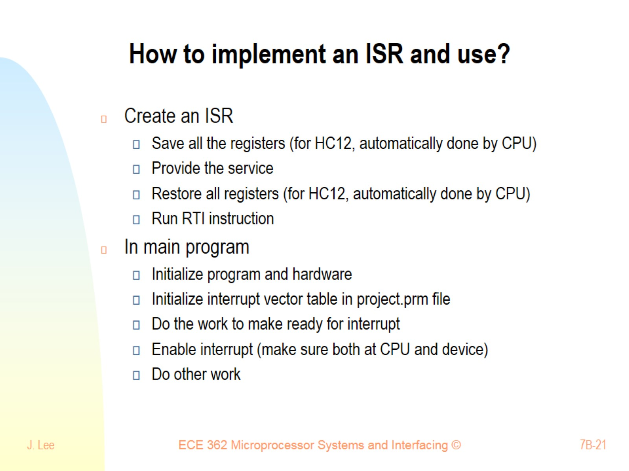
How to implement an ISR and use?

Slide 22
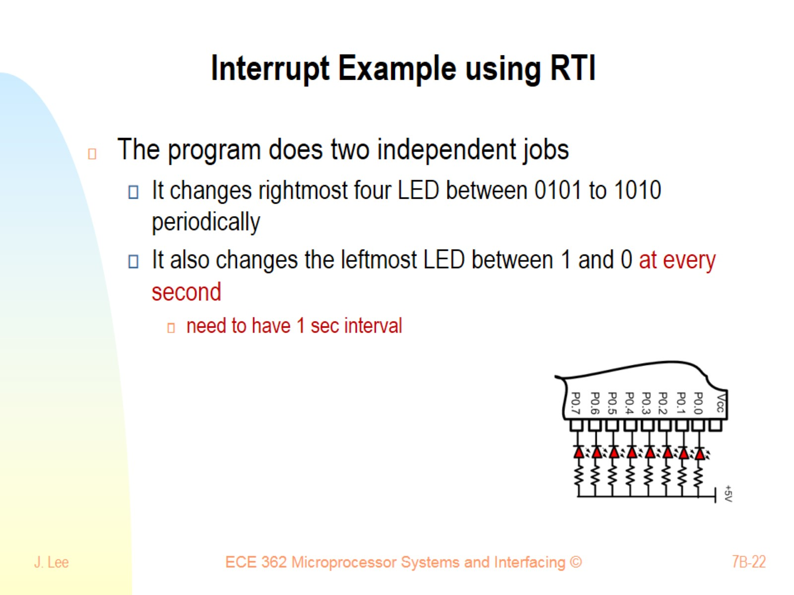
Interrupt Example using RTI

Slide 23
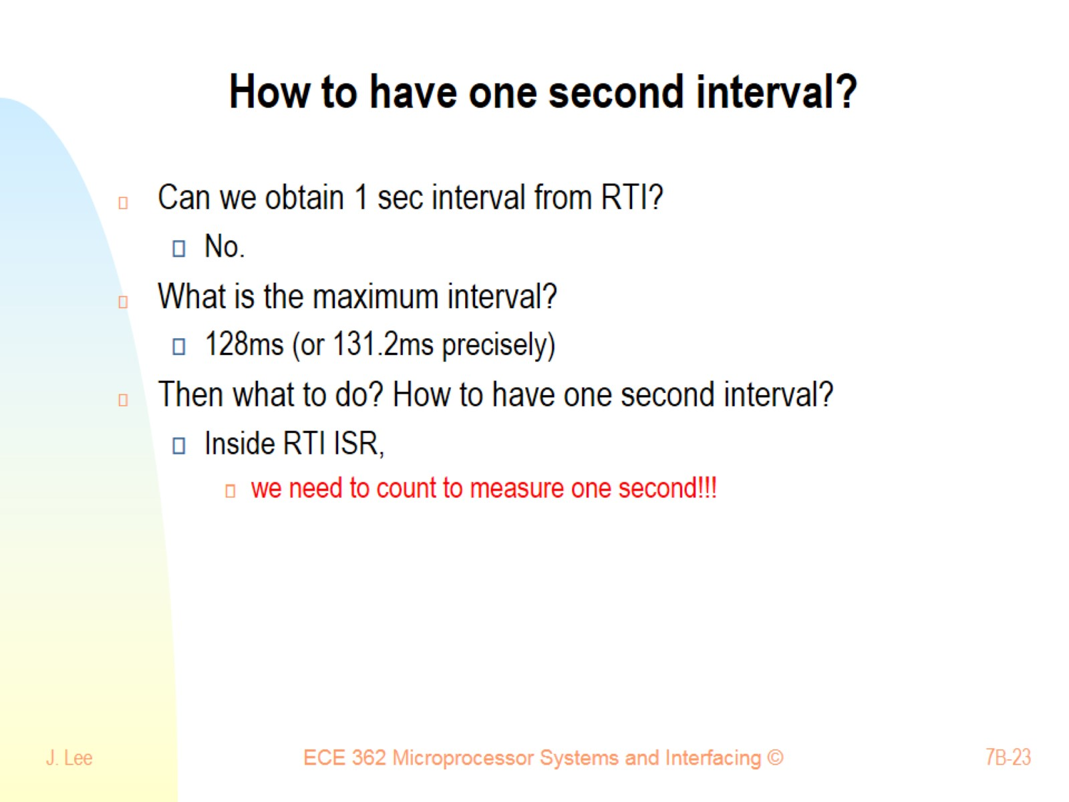
How to have one second interval?

Slide 24
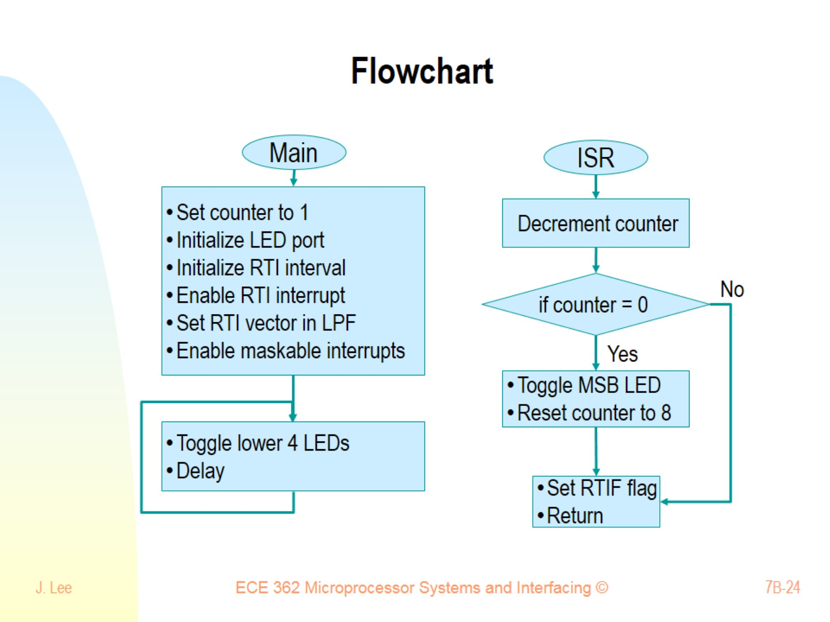
Flowchart

Slide 25
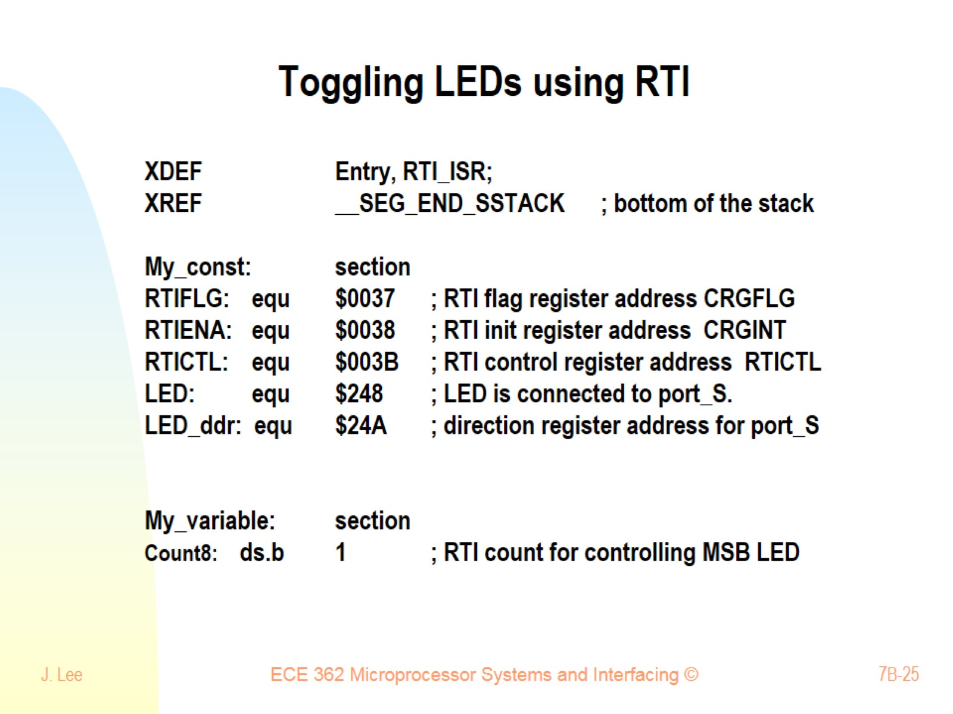
Toggling LEDs using RTI

Slide 26
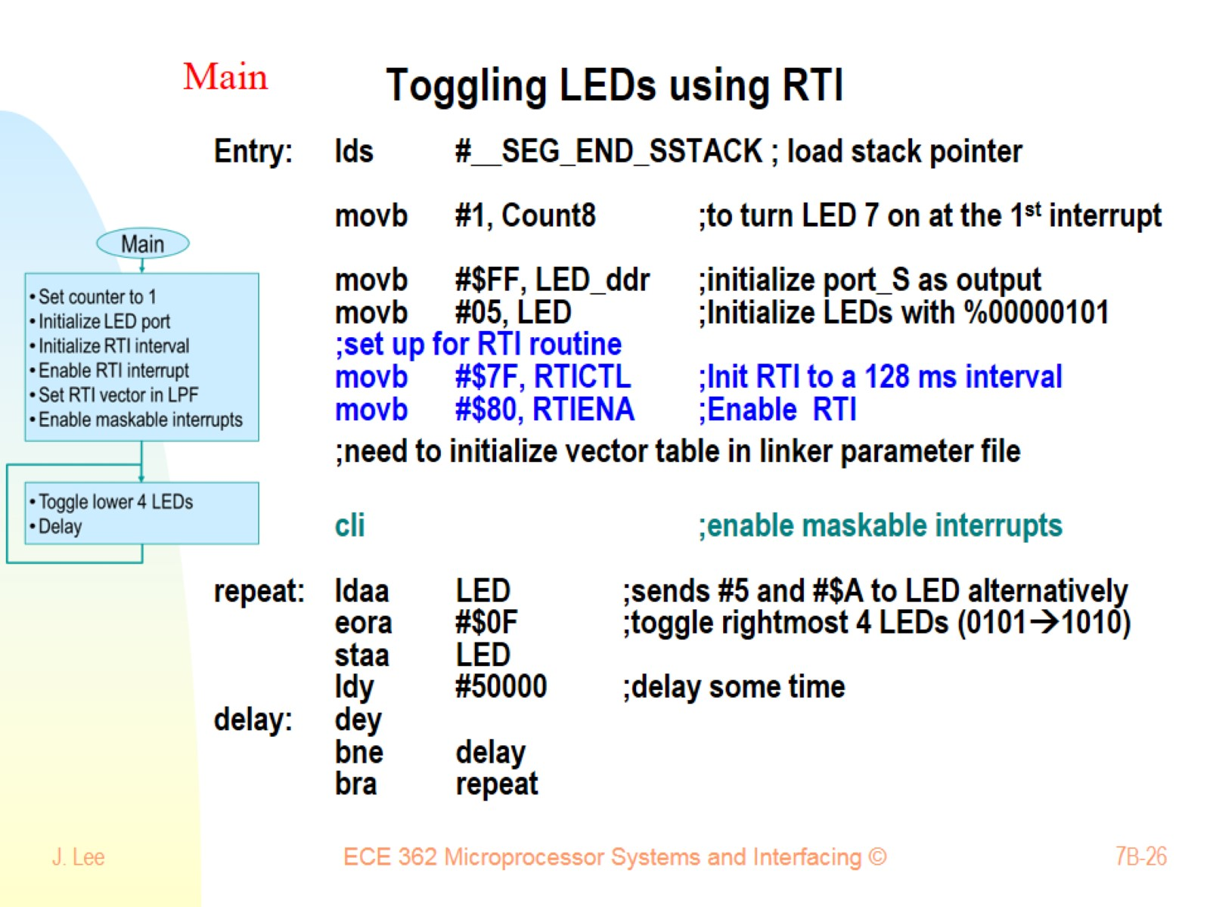
Toggling LEDs using RTI

Slide 27
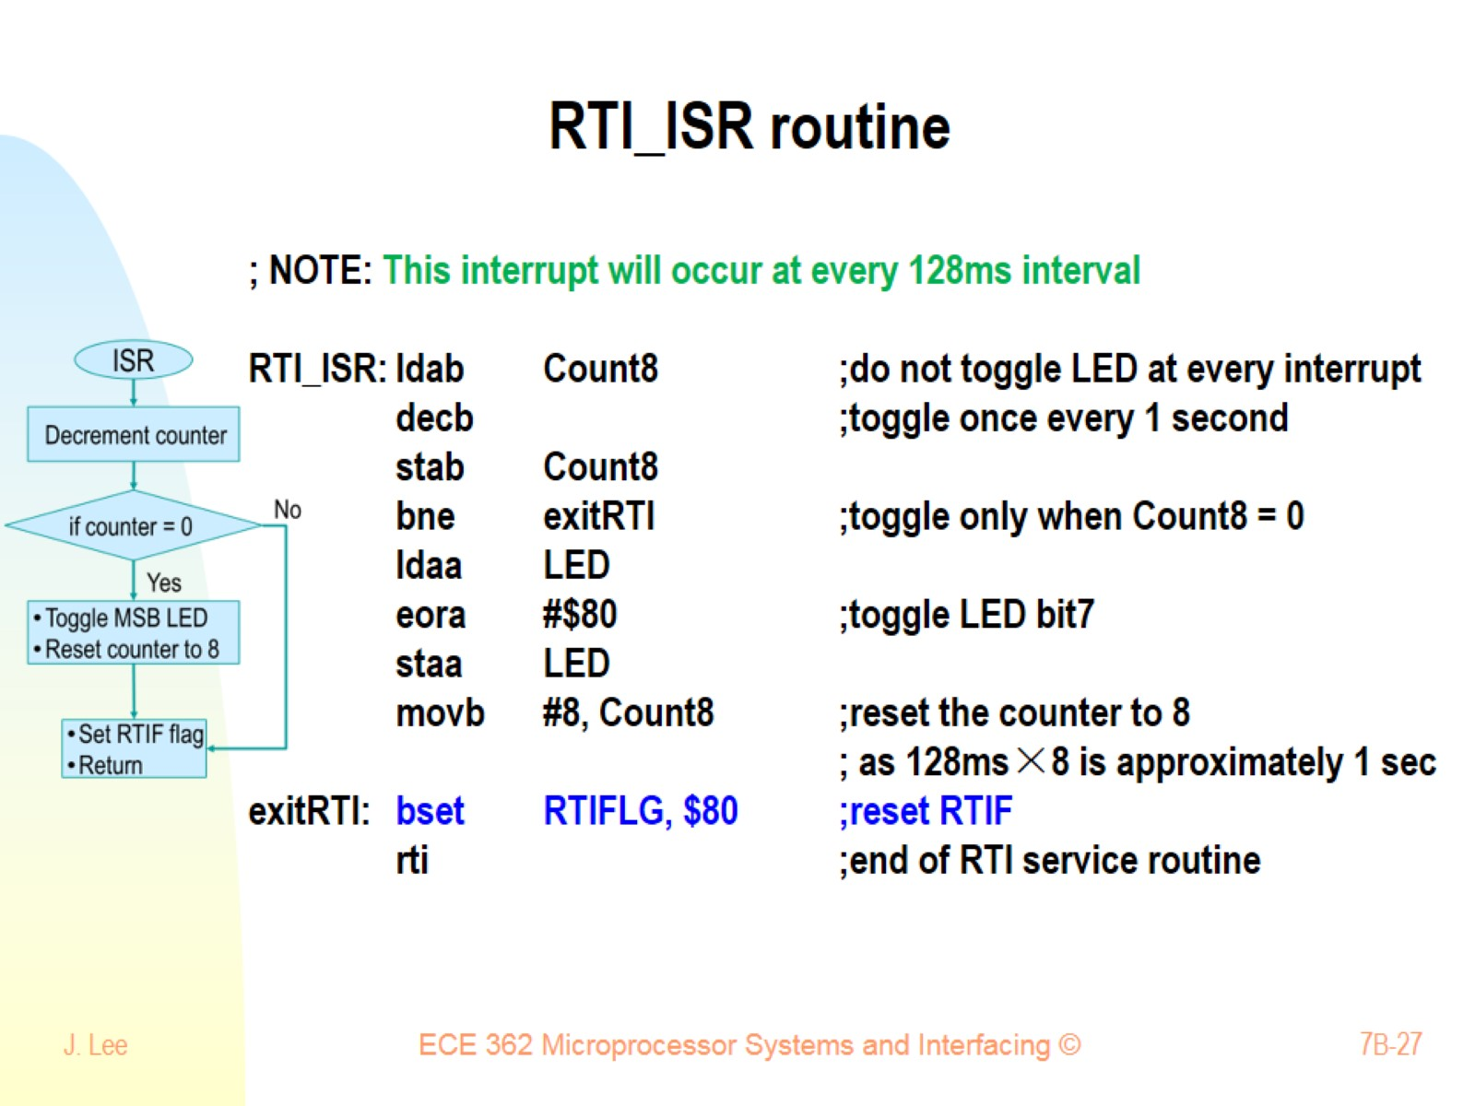
RTI_ISR routine

Slide 28
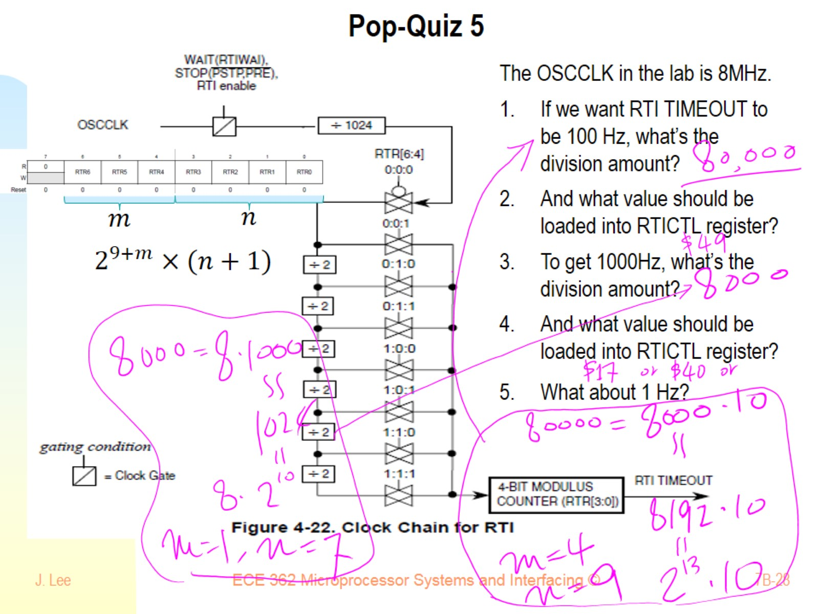
Pop-Quiz 5

Slide 29
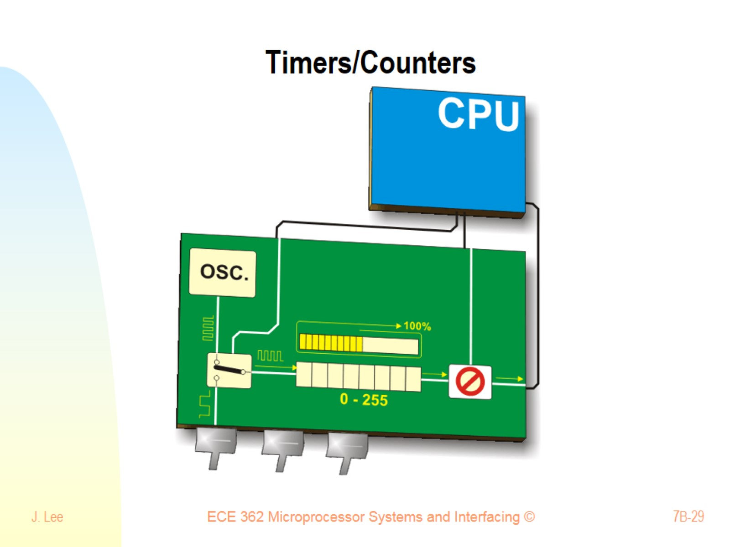
Timers/Counters

Slide 30
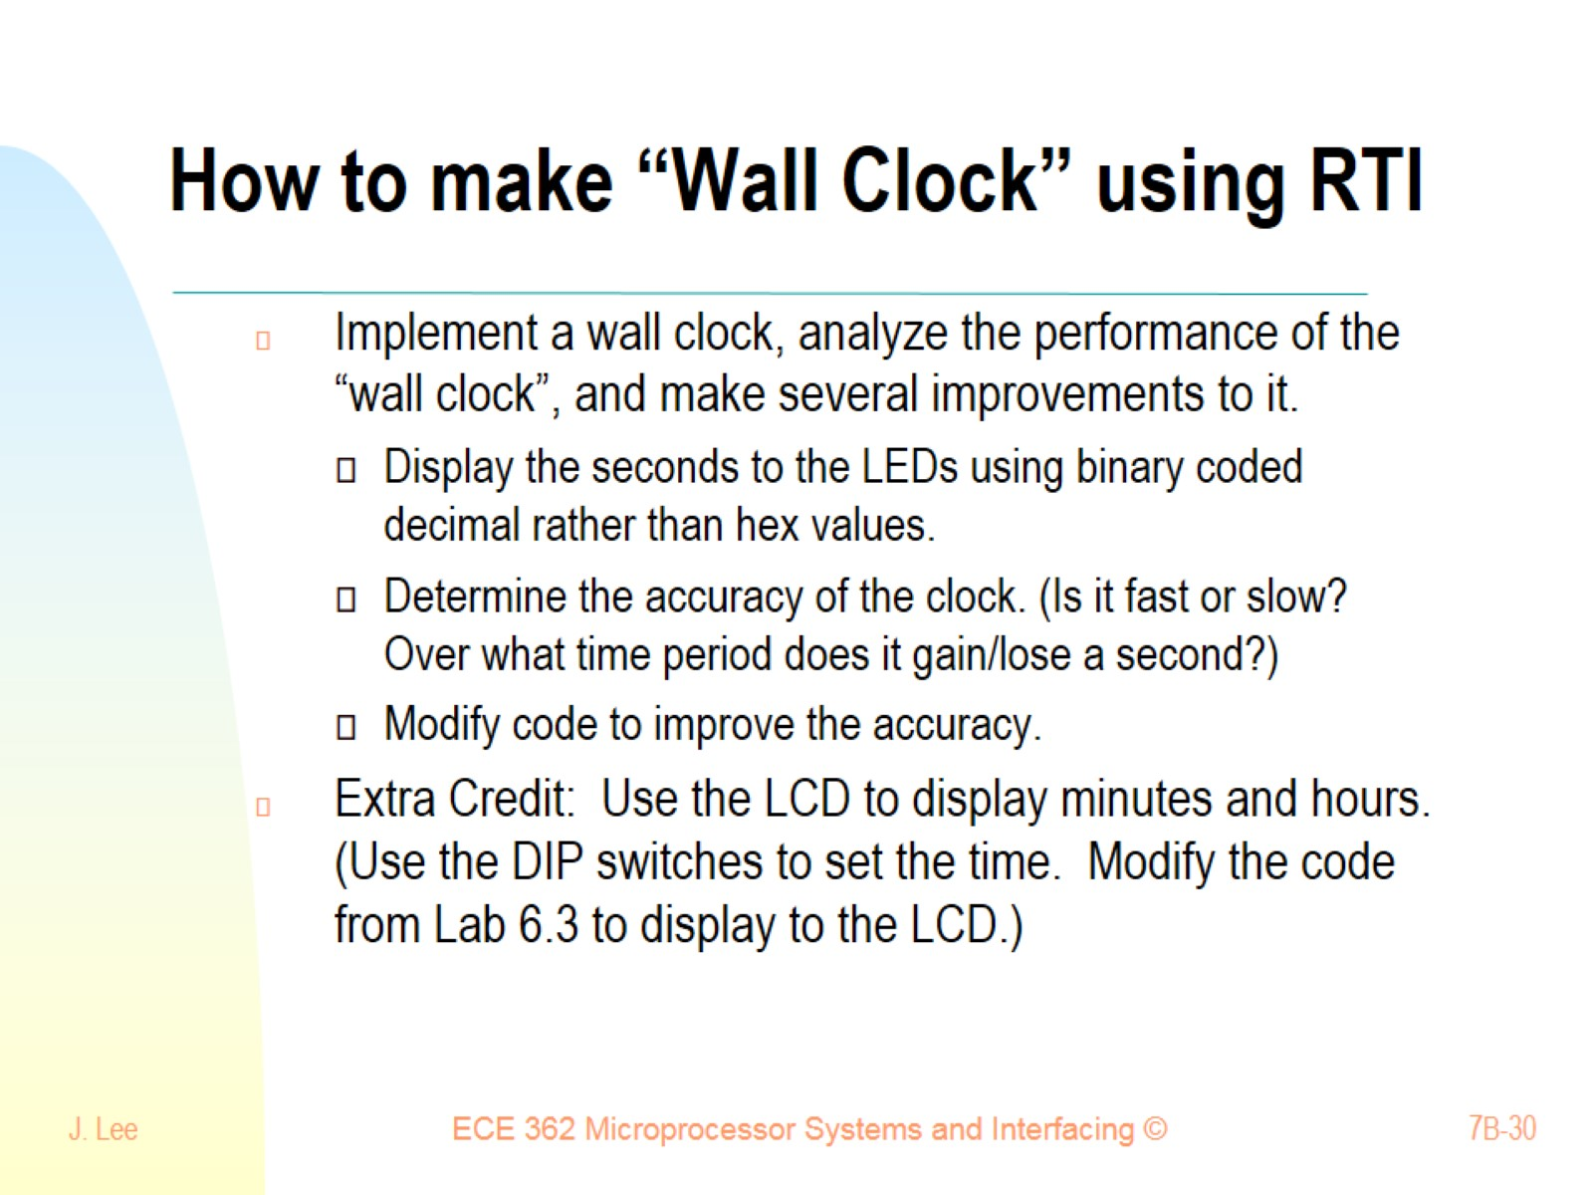
How to make “Wall Clock” using RTI

Slide 31
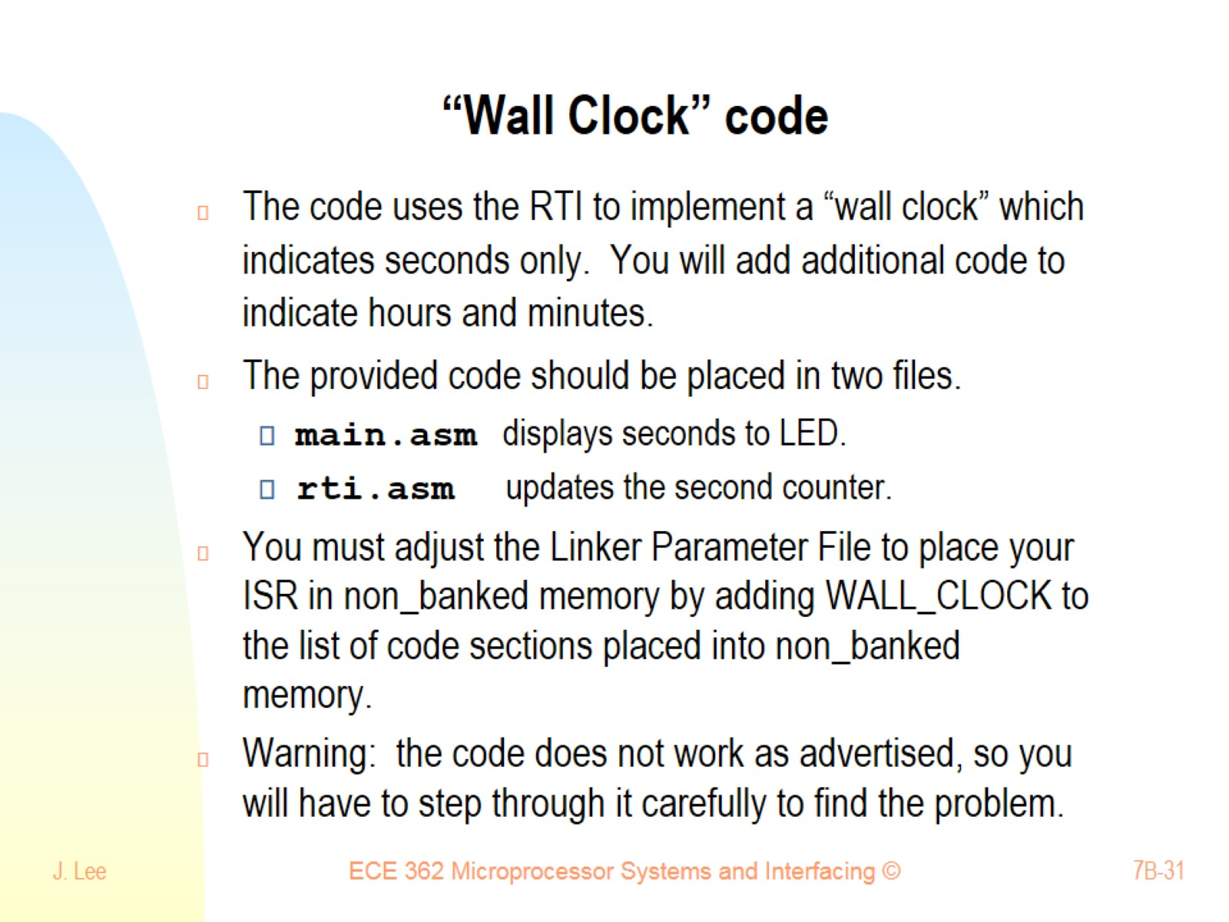
“Wall Clock” code

Slide 32
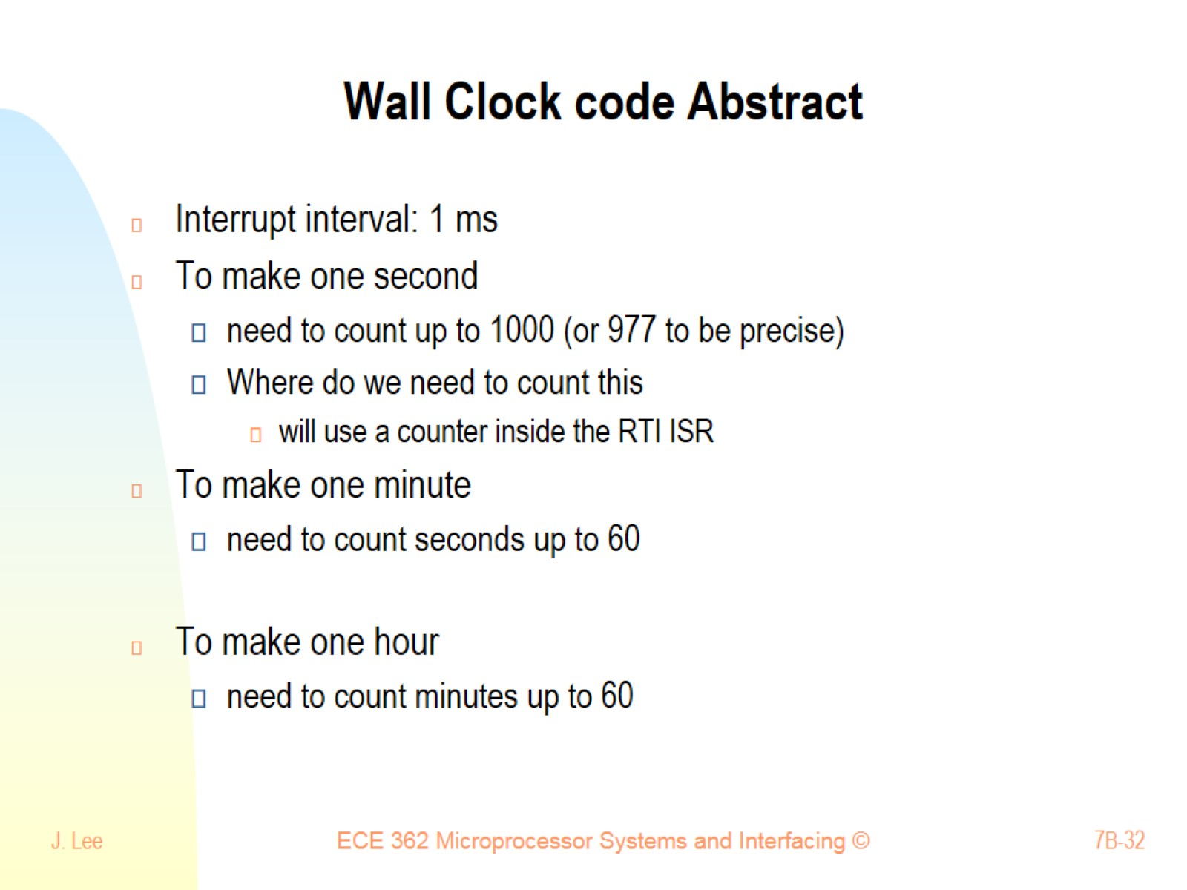
Wall Clock code Abstract

Slide 33
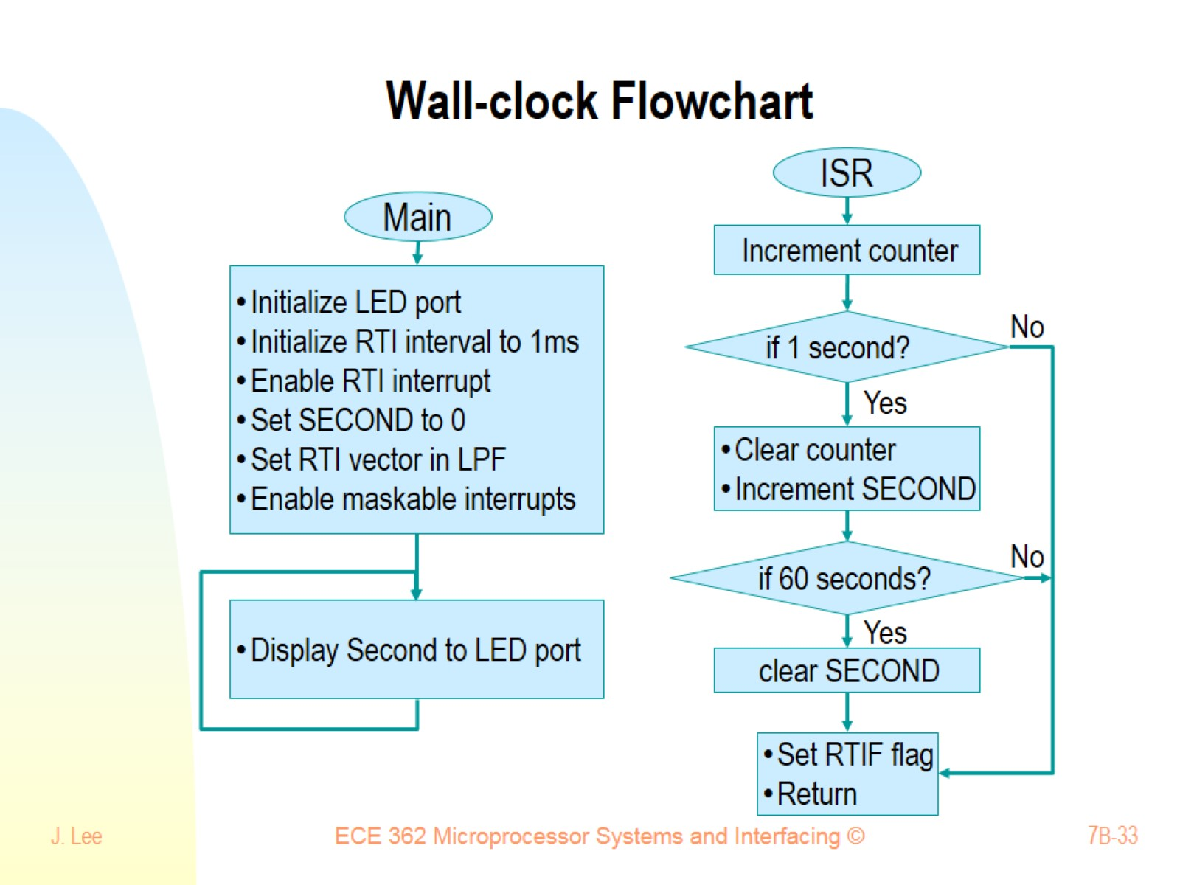
Wall-clock Flowchart

Slide 34
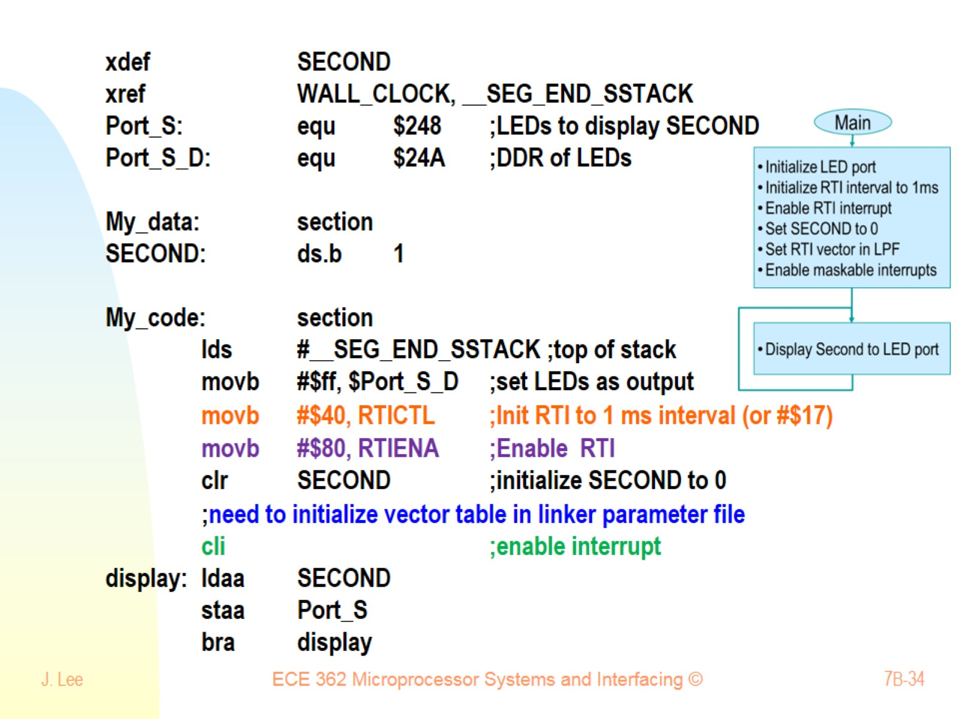

Slide 35
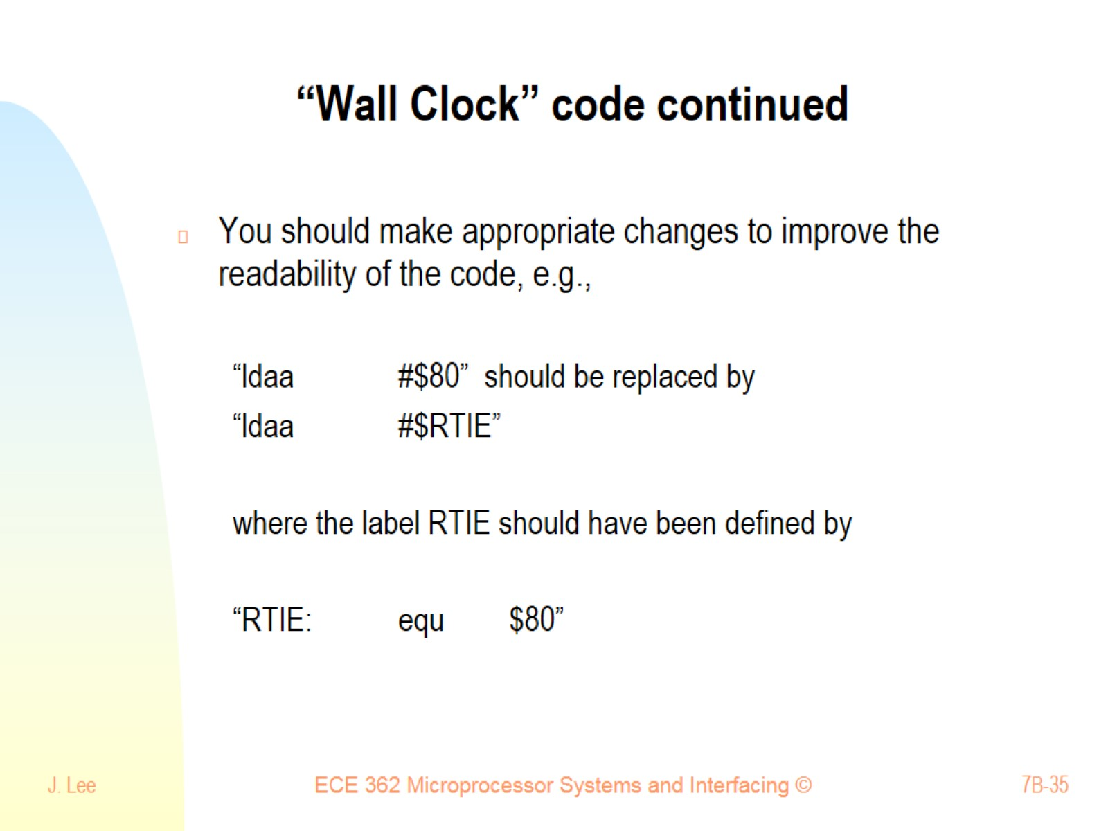
“Wall Clock” code continued

Slide 36
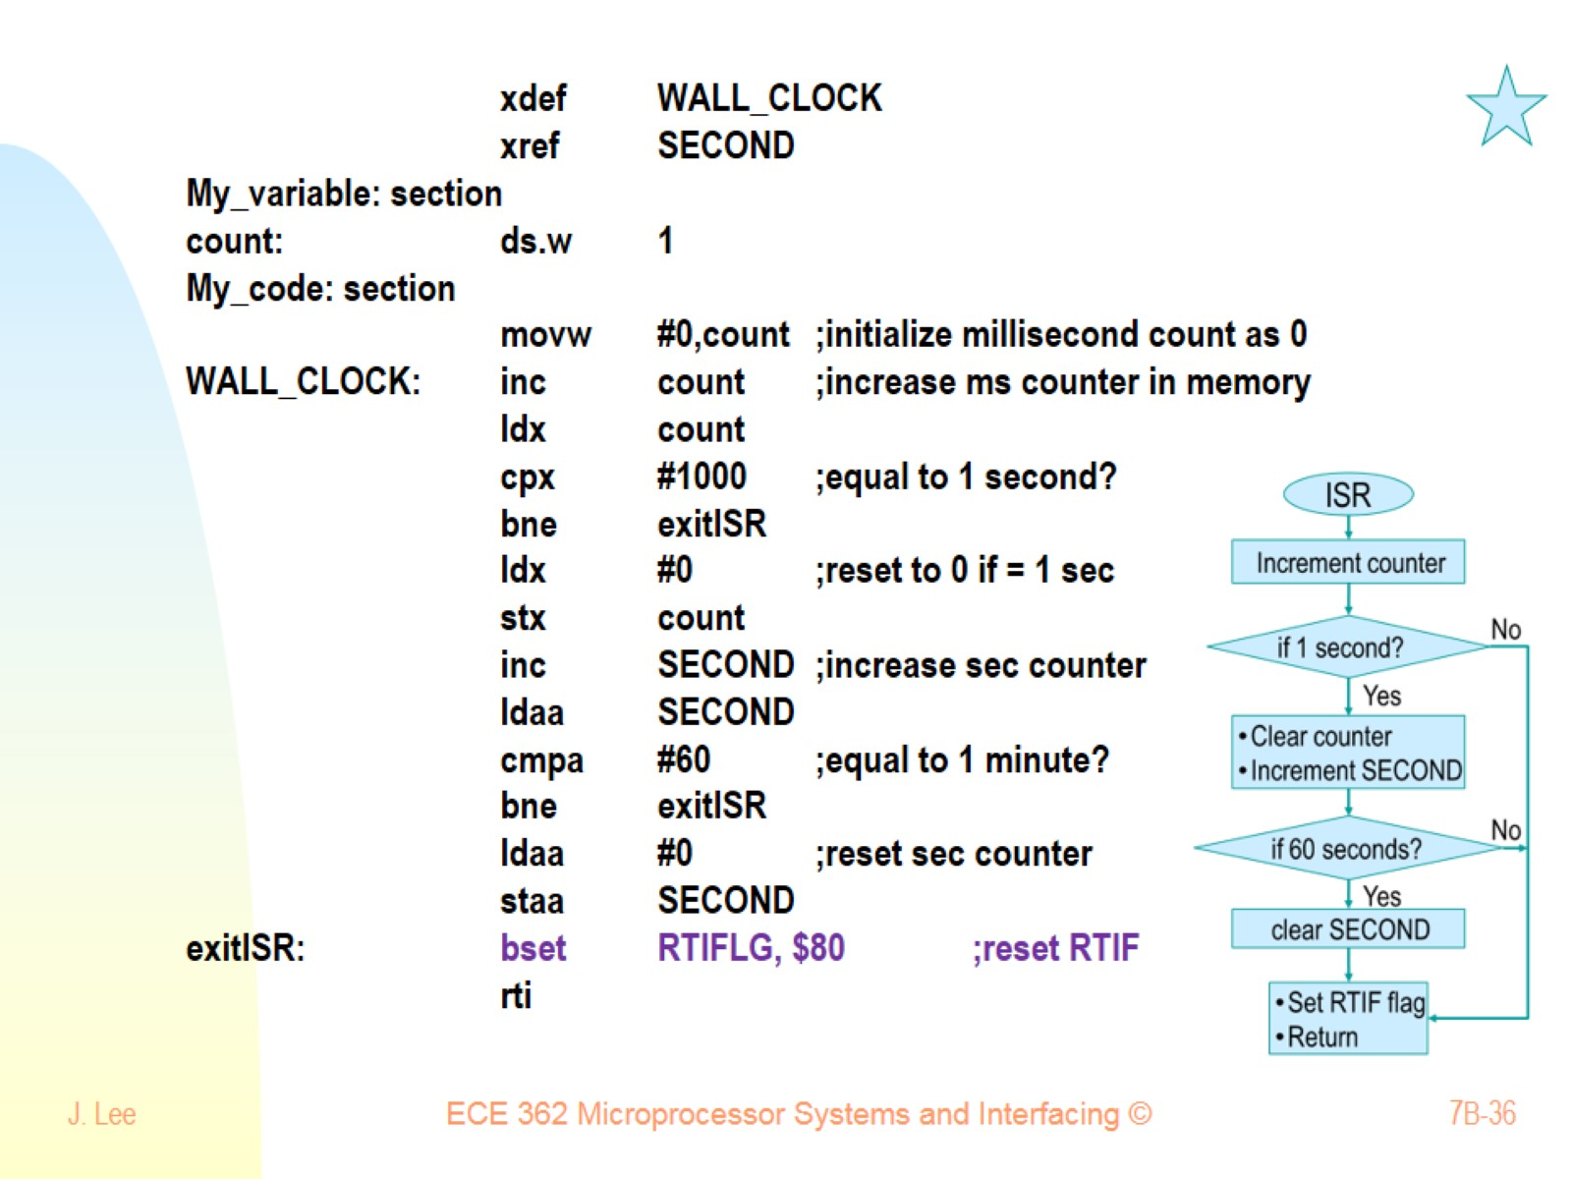

Slide 37
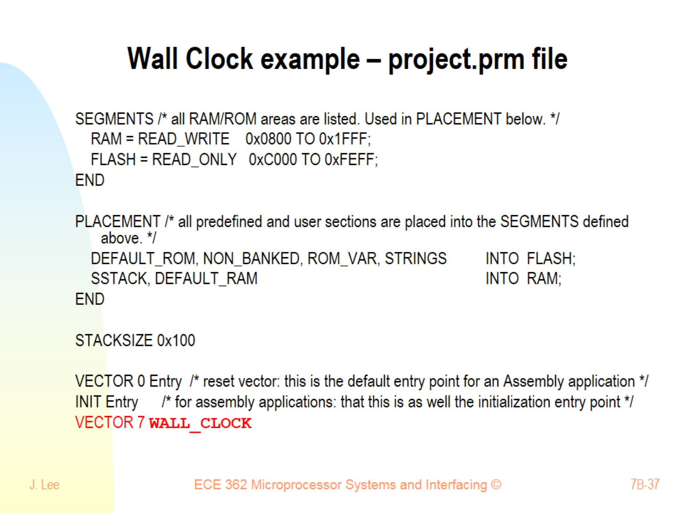
Wall Clock example – project.prm file

